Slide 1
HTML 5
The joke is on you

Slide 2
Test results

Slide 3
Final project
4-page website
Home
Contact
Gallery
About

Slide 4
Final Project – CSS
You must use CSS to style your 4 pages
The 4 pages must have the same style
You may use an internal or external stylesheet for this
Style (at minimum): background color, link color, font, margin, padding, and at least one border
You must use class notation to style different elements types (tags) with CSS

Slide 5
Final Project – Gallery
Add some pictures. They don’t have to be of you.
Use the alt tag
Set the height / width for consistent sizing (use inline CSS or your stylesheet)
Add video or audio using HTML 5 controls

Slide 6
Final Project -- NavBar
Must include a nav bar.
Can be horizontal or vertical
Must use the <nav> element
Must have ‘block’ property and text decorations removed
Must be on every page on a consistent manner
You can include the code on every page for this
Extra credit
Use iframes to load the content and have the navbar be included once
Use id=“active” to style the active tab differently than the others

Slide 7
Final Project – Contact
Use HTML forms to present the option for user input
Clicking “submit” does not have to work
Must use
Text or textarea
Checkbox or radio
Dropdown (select)
Buttons titled “submit” and “cancel”

Slide 8
Final project – Home and About
Use HTML semantic elements. Don’t use div id=“header” or div id=“aside”
Must use:
Section
Article
Header
Footer
Extra credit:
Use an “aside” to style something to the side of main content

Slide 9


The joke is on you…we’ve already been doing HTML 5 (a little)
z

Slide 10

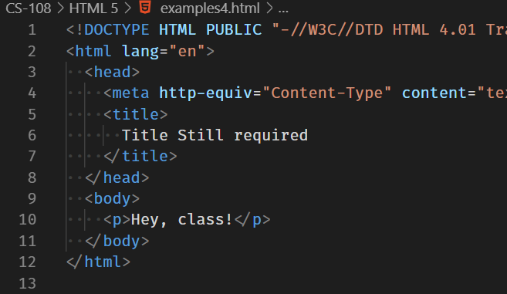
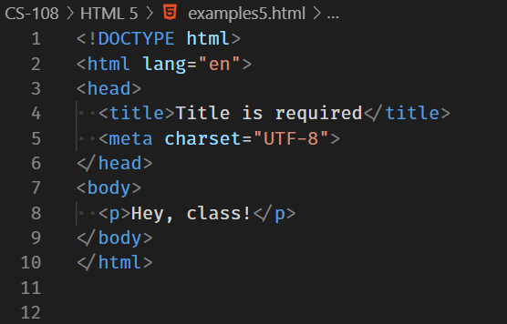
What we’ve done
Our doctype and meta tags are the HTML 5 standard

Slide 11
What does HTML 5 give us?
What about the web has changed?
First draft 2007
Candidate Recommendation 2012
Recommendation 2014

Slide 12

My perception of changes
Audio and video have taken over
Search engine optimization is critical to a company’s online success
People access the web from more devices and more places
Commitment to accessibility

Slide 13
Audio and video
What audio and video plugins do you need in your browser to have a good experience?
If I had asked you this question in 2005 your answer would have been much different

Slide 14
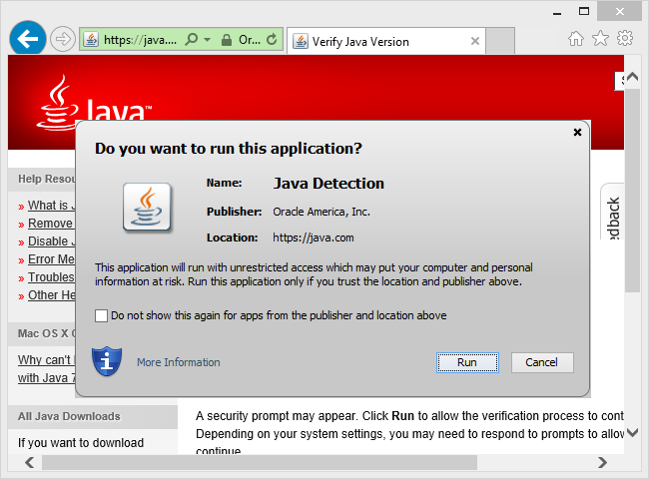
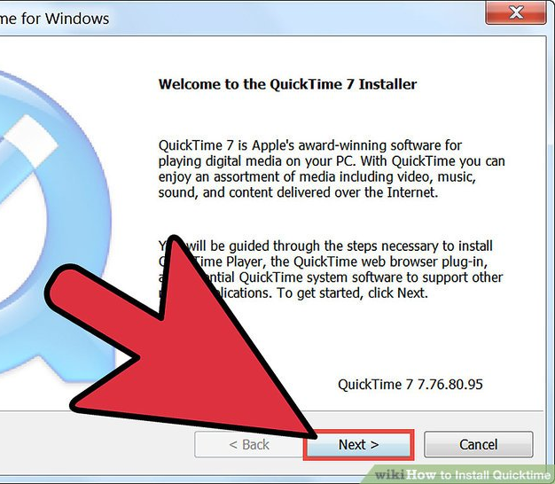
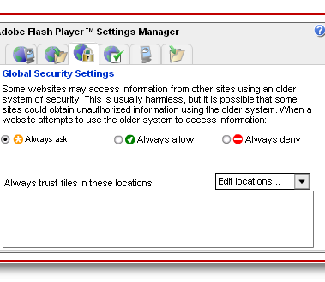
Audio / Video Plugins
This wasn’t very fun

Slide 15
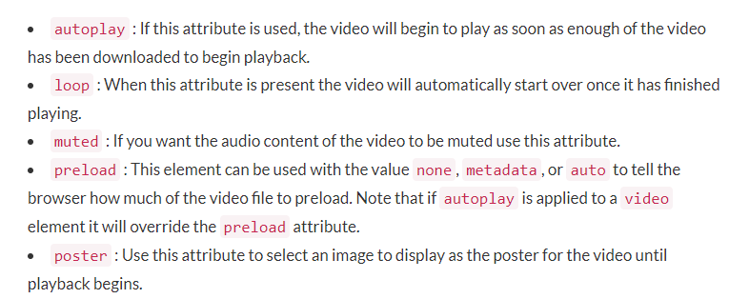
HTML new elements
<audio> and <video> elements
Multiple optional elements
Source examples
<track> element lets you add subtitles

Slide 16
Audio and Video
Controls – don’t bother your users!
Autoplay – don’t’ bother your users!
Height / Width (video) – smoother load
Preload -- “auto” unless you know what you’re doing

Slide 17
New graphic elements
<svg> and <canvas>
What if you didn’t need to host images?
You could just tell the browser to draw them.
SVG graphics become part of the DOM. We can change them with JavaScript
Vector graphics can be resized
SVG images can be searched, indexed, scripted, and compressed

Slide 18
Why do you want to do this?
Smaller devices or limited bandwidth
Instagram filters!
User created pictures (crop / modify photos)
Drop shadows
Porthole

Slide 19
Mobile first
Changing the viewport
We will cover this more in the responsive web class

Slide 20
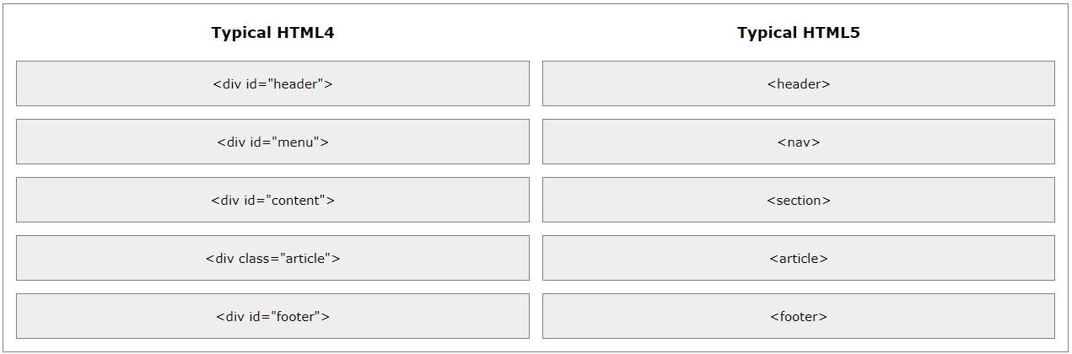
Semantic elements
z

Slide 21
Lots of new stuff
Time
Input type “email” lets your phone put the .com in the keyboard
Progress

Slide 22
In class assignment
Use semantic elements to create 3 pages
Home.html – where most of your content is
Back.html – the “previous” page
Next.html – the “next” page
Use:
Header
Nav
Section
Article
footer

Slide 23
Example

